Slide 1
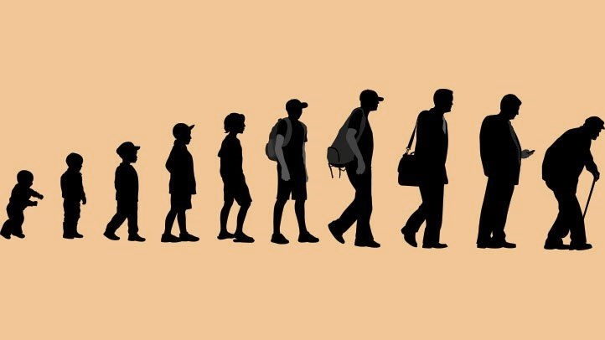

Study of Life Expectancy and Affecting Factors
PROJECT DONE BY
N.MUTHAMILARASU
PGDDM-29
UNDER THE GUIDANCE OF
MRS.BHAVANI SHAKARI

Slide 2
Context
Introduction to Life Expectancy and affecting Factors
Introduction to DAV
Python libraries
Explanation of Variables
Analysis of Dataset
Results of Analysis
Conclusion

Slide 3
demography
Demography is the study of human population in relation to size, composition and distribution Population keeps on changing in these aspect year to year. Country to country. India's population has been continuously increasing since 1921. And it projected to cross 1.53 billion by the year 2050. The population of India is studied in various aspects.
Composition of population
Density of population
Urbanization
Literacy & education
Expectation of life
In this project we are analysing data related to Life expectation which comes under the last topic.

Slide 4
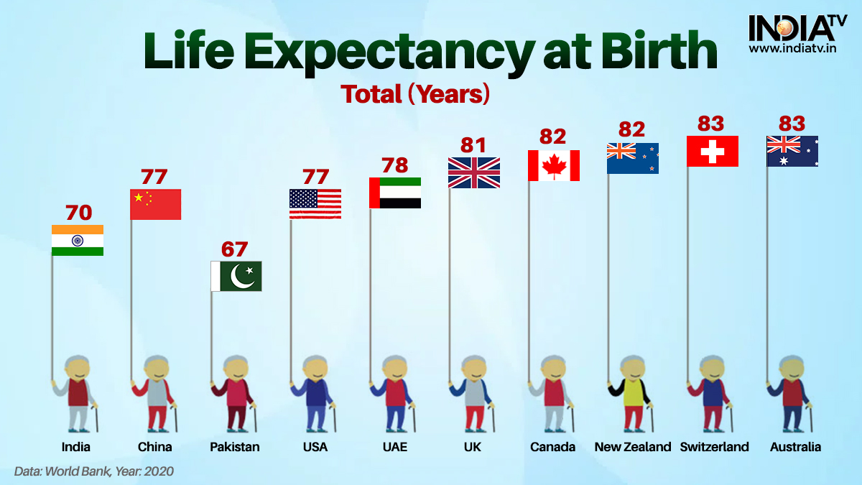
Introduction To Life Expectancy and affecting factors
The World Health Organization defines life expectancy as
“The average number of years a person is expected to live on the basics of the current mortality rates and prevalence distribution of health states in a population”
Life expectancy is a statistical measure of the estimate of the span of a life. It is sometimes used referring to inanimate objects, i.e. a building, but is generally used to estimate the average life span of living things, more specifically human life.

Slide 5

Life expectancy at age x is measured using the following formula:
Tx=Number of survivors at the age of x
lx=Total number of person-years lived above age x
I predict that human life expectancy will not continue to grow over the next 100 years; the tendencies of death rates and oncoming illness will outmatch our technological and medical abilities and disable us from fighting newly formed diseases in amounts high enough to reach a higher life expectancy

Slide 6
Statistics released by the Union ministry of health and family welfare show that life expectancy in India gone up by five years, from 62.3 years for males and 63.9 years and females in 2001-2005 to 67.3 years and 69.6 years respectively.
The average life expectancy at birth has increased from 49.7 during 1970-75 to 69.0 in 2013-17, registering an increase of 19.3 years during this period. As per the same report, the life expectancy at birth for male and female during 2013-17 were 67.8 and 70.4 years respectively.
The average life expectancy at birth has increased from 49.7 during 1970-75 to 69.7 during the year 2015-19 registering an increase of 20 years during this period.

Slide 7
Statistics by union ministry of health and family welfare

Slide 8
Life expectancy in India for the past 60 years

Slide 10
India: Life expectancy
Male
Female
Both
Ranking
60.3
60.4
60.3
129
According to WHO data published in 2019 life expectancy in India is Male 60.3, female 60.4 and total life expectancy is 60.3 which gives India a World Life Expectancy ranking of 129

Slide 11
Causes of high Life expectancy
Advanced in Public health, nutrition, and medicine
Advanced Higher Education
High Per-Capita Income
Increased production of Food and Shelter
Government Policies
Examples- Global- Singapore , Japan
India- Kerala

Slide 12
Causes of low life expectancy
Perinatal (Death immediately before and after birth) and maternal conditions, taking the lives of children and mothers.
Injury, riots and violence caused death at an “epidemic proportion”
There were non-communicable diseases such as stroke, heart disease, diabetes, chronic lung diseases and cancer.
Low level of education
Unequal distribution of clean water
Examples- World- Most of the African Countries
India- Assam, UP, Bihar

Slide 13
Data visualization
Data visualization is the process of creating graphical representations of information. This process helps the presenter communicate data in a way that's easy for the viewer to interpret and draw conclusions and make decisions,
Data visualization is the process of displaying data in graphical charts, figures and bars and pictograms. Making it visualize makes it easier to understand

Slide 14
Why Data Visualization ?
Data Visualization tools helps to make sense of data
Data Visualization helps companies increase confidence and avoid making very risky decisions.
Data Visualization professionals are highly valued in the market place.
Data visualization helps business take decisions based on the understanding
data from Data visualization tools.
Business Intelligence is achieved by good data visualization

Slide 15
DATA ANALYSIS
Analysis of data is a process of inspecting, cleaning, transforming, and modelling data with the goal of discovering useful information, suggesting conclusions, and supporting decision making.
Data analysis has multiple facts and approaches, encompassing diverse techniques under a variety of names, in different business, science, and social science domains

Slide 16
Data analysis using python libraries
Pandas
Pandas is a python library used for working with datasets. It has functions for analysing, cleaning, exploring, and manipulating data.
NumPy
NumPy is a Python package. It stands for Numerical Python. It is a library consisting of multidimensional array objects and a collection of routines for processing of array.

Slide 17
Matplotlib
matplotlib is a python 2D plotting library which produces publication quality figures in a variety of hardcopy formats and interactive environments.
Seaborn
Seaborn is a Python visualization library based on matplotlib. It provides a high-level interface for drawing attractive statistical graphics.
Plotly
Plotly Library is an open-source library that can be used for data visualization and understanding data simply and easily. Plotly supports various types of plots like line charts, scatter plots, histograms etc.

Slide 18
variations
The data frame has following variations
Country, Year, Status, Life Expectancy, Adult Mortality, Infant Deaths, Alcohol, Percentage Expenditure, Hepatitis B, Measles, BMI, Under Five Deaths, Polio, Total Expenditure, Diphtheria, HIV/AIDS, GDP, Population, thinness 1-19 years, thinness 5-9 years, Income composition of resources, Schooling

Slide 19
Explanation of variations
Country: Country
Year: Year
Status: Classification of countries as 'developed' or 'developing' based on their gross domestic product(GDP).
Life expectancy: Life expectancy (years of age).List item
Adult Mortality : Adult Mortality Rates of both sexes (Probability of dying between 15 and 60 years per 1000 population
Infant deaths: Number of Infant (0-1 year of age) Deaths per 1000 population

Slide 20
Alcohol: Alcohol, recorded per capita (15+) consumption (in liters of pure alcohol).
Percentage expenditure: Expenditure on health as a percentage of GPD per capita. (%)
Hepatitis B: Hepatitis B immunization coverage among 1-year-olds. (%)
Measles: Number of reported cases per 1000 population.
BMI: Average Body Mass index of entire population
Under-five deaths: Number of under-five deaths per 1000 population
Polio: Polio immunization coverage among 1-year-olds (%)List item

Slide 21
Total expenditure: General government expenditure on health as a percentage of total government expenditure (%) List item
Diphtheria: Diphtheria tetanus toxoid and pertussis (DTP3) immunization coverage among 1-year-olds (%)
HIV/AIDS: Deaths per 1000 live births HIV/AIDS (0-4 years)
GDP: Gross Domestic Product per capita (in USD)
Population: Population of the country
Thinness 1-19 years: Prevalence of thinness among children and and adolescents for Age 10 to 19 (%)^2

Slide 22
Thinness 5-9 years: Prevalence of thinness among children for Age 5 to 9 (%)
Income composition of resources: Human Development Index in terms of income composition of resources (index ranging from 0 to 1)
Schooling: Number of years of Schooling (years)

Slide 23
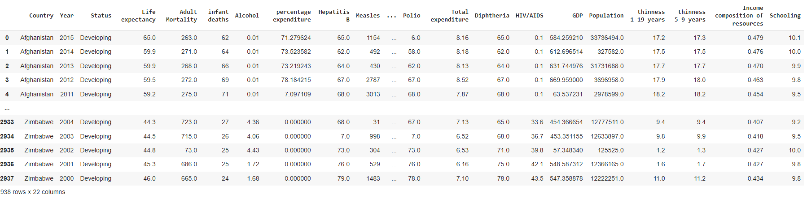
LOADING DATASET

Slide 24
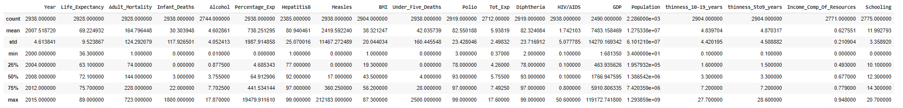
ANALYSING THE STATISTICAL FUNCTION

Slide 25
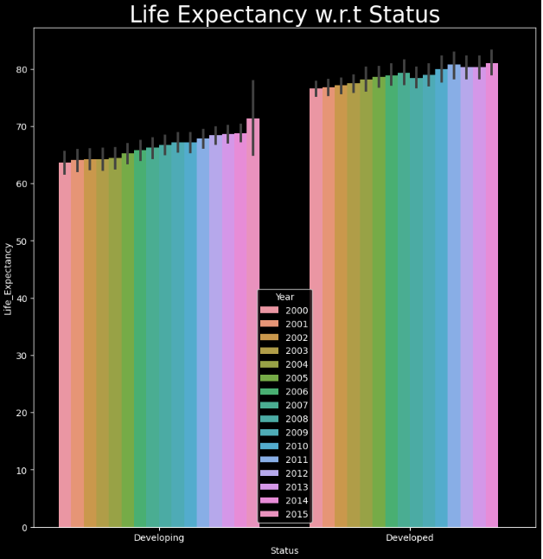
ANALYSING THE LIFE EXPECTANCY

Slide 26

Results of the analysis provides
Descriptive statistics of various columns
Differentiate the life expectancy with respect to countries.
Findings about the diseases and the impact caused which affects the life expectancy
Analysis of important fields using scatterplot
Overall description about the factors related to life expectancy
Expect a better life expectancy by lowering the infant deaths, increasing the per-capita income(GDP), sustainable policies of a country, better hospitalization

Slide 27
conclusion
Human life expectancy will fluctuate, but not continue to grow until we can breach our social, economic, etc. problems with successful medical tactics
Disease is becoming more prevalent, and proportionally inhibiting large populations; causing major health concerns and longevity problems

